Slide 1
Solar Array Emulation in the NIST SG PCS system
Overview and tutorial
Allen Goldstein

Slide 2
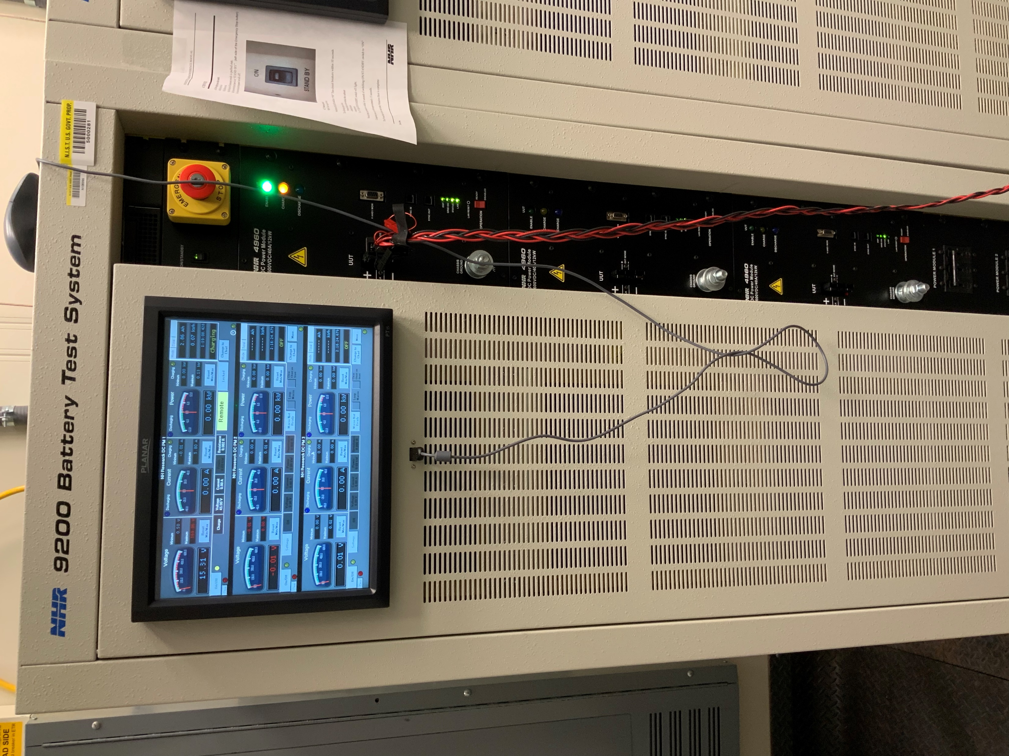
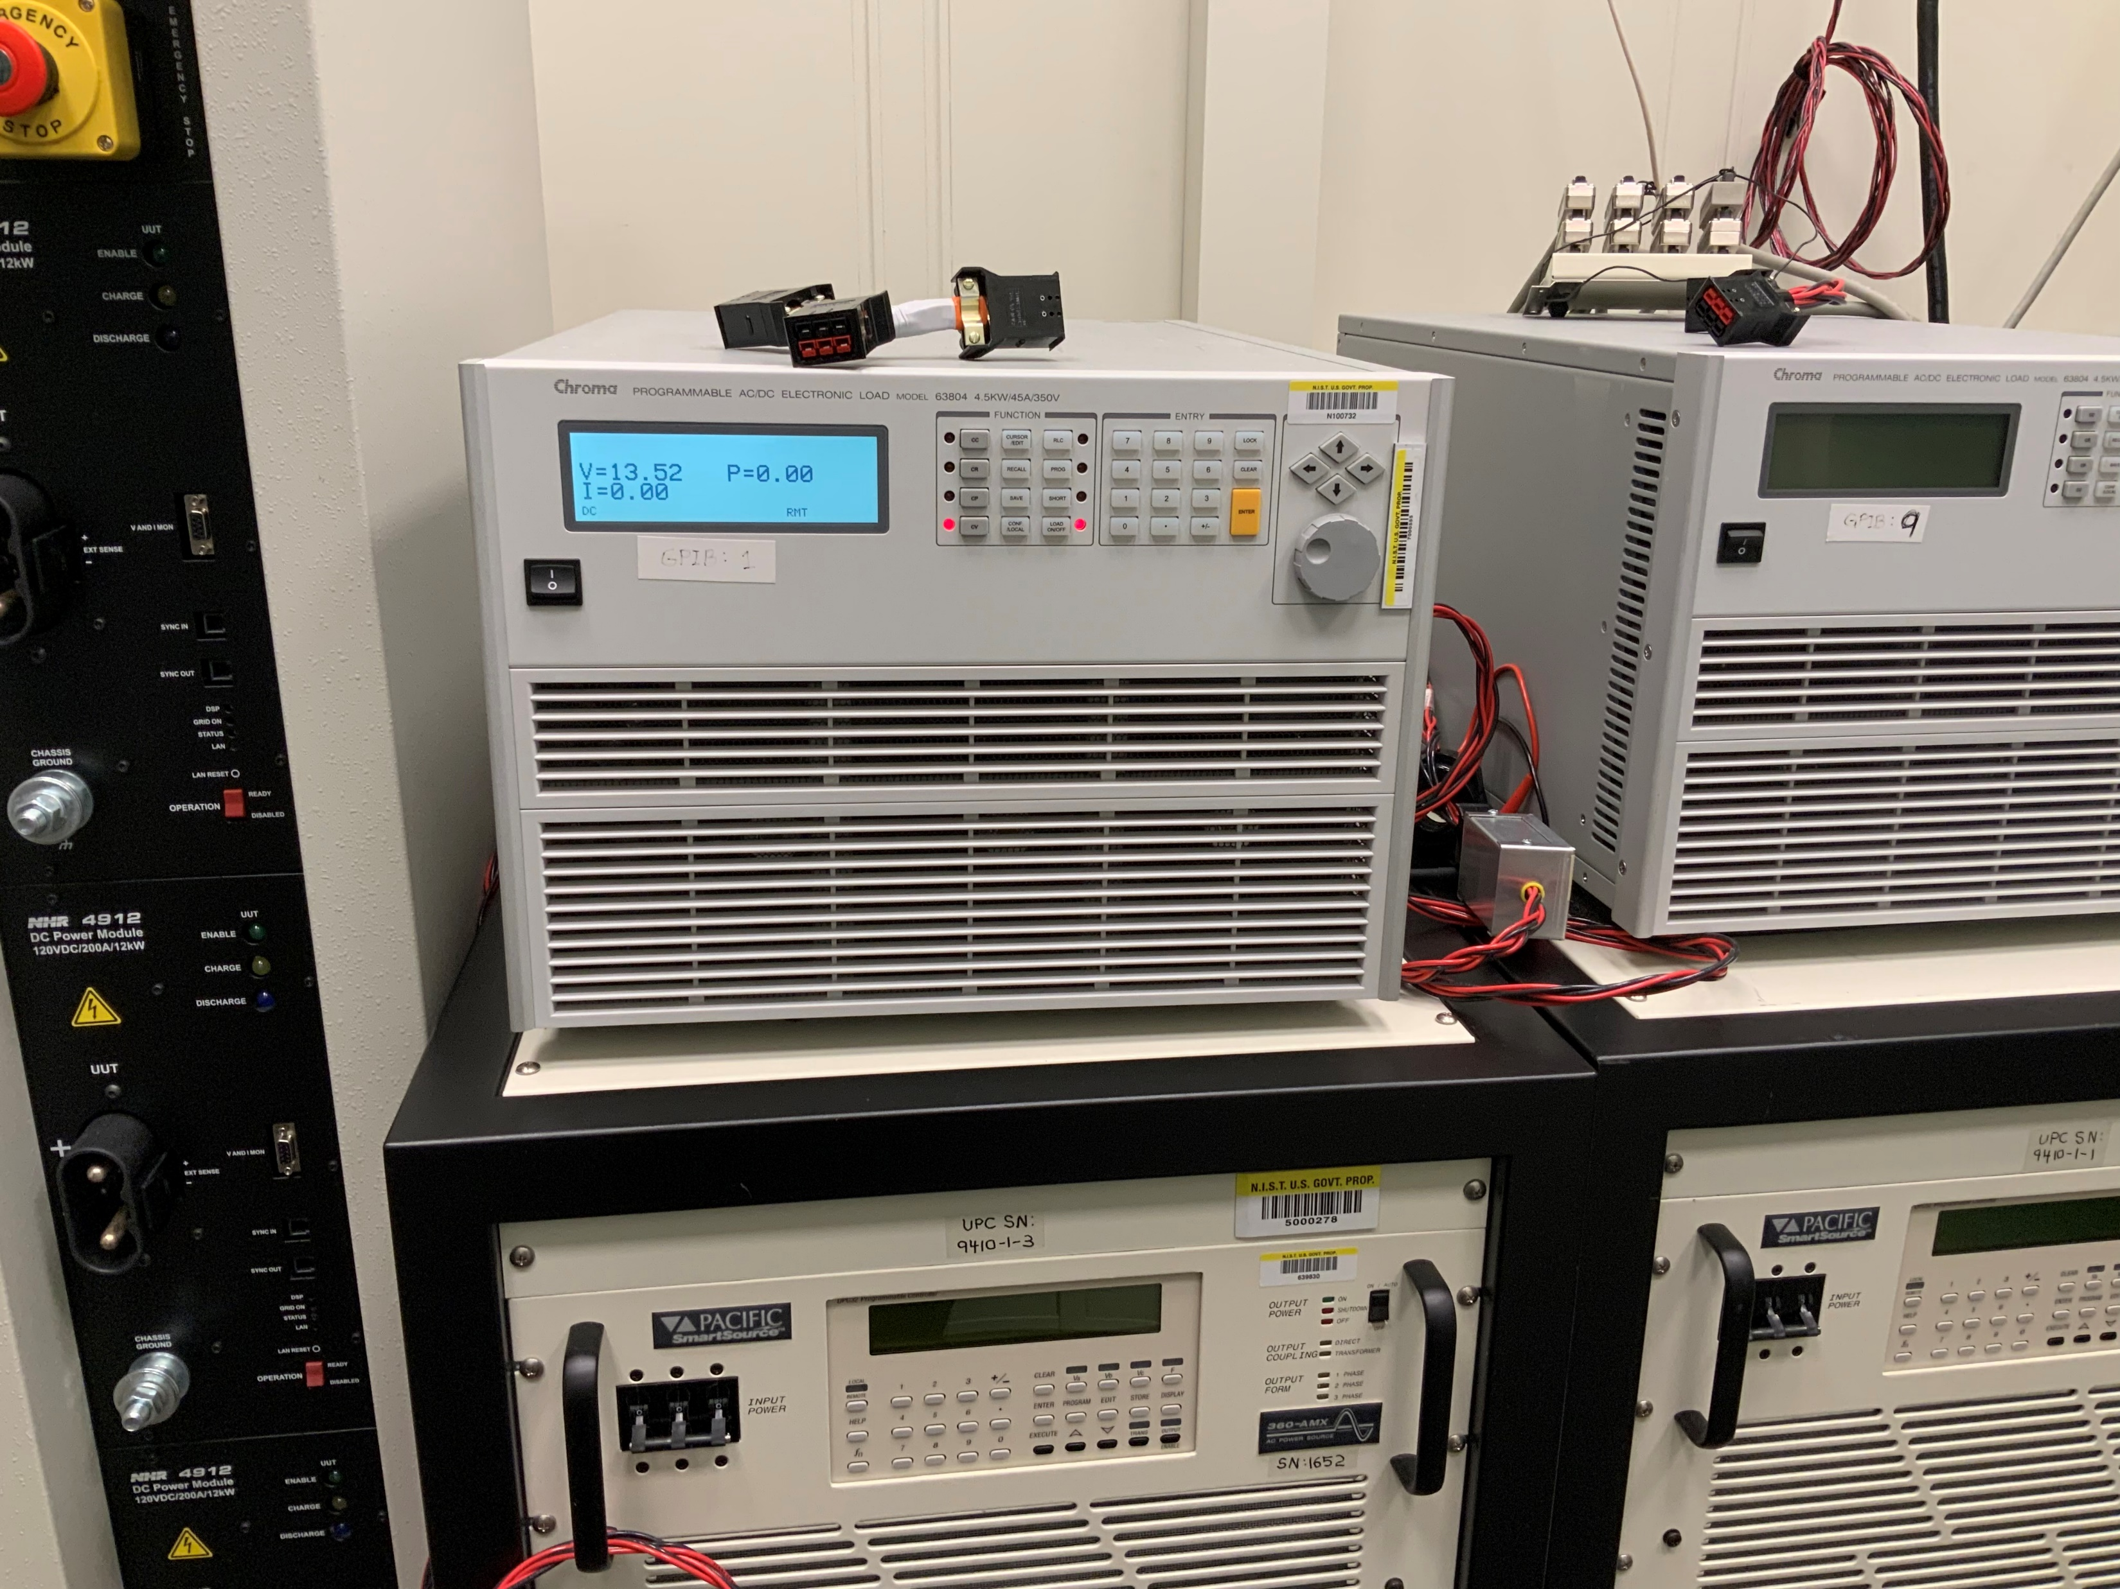
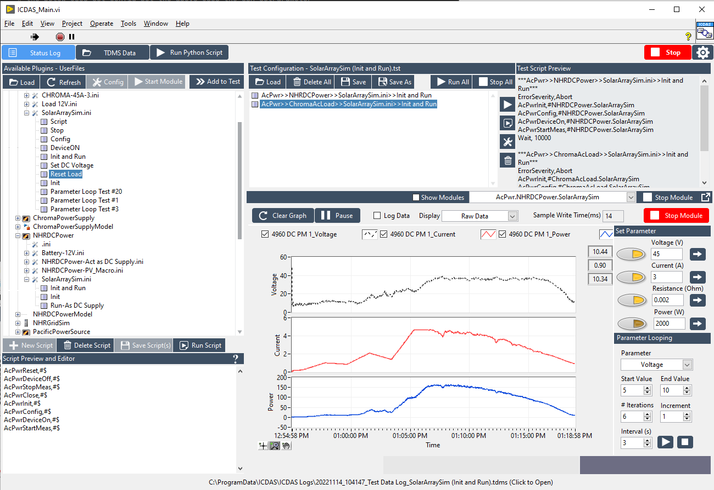
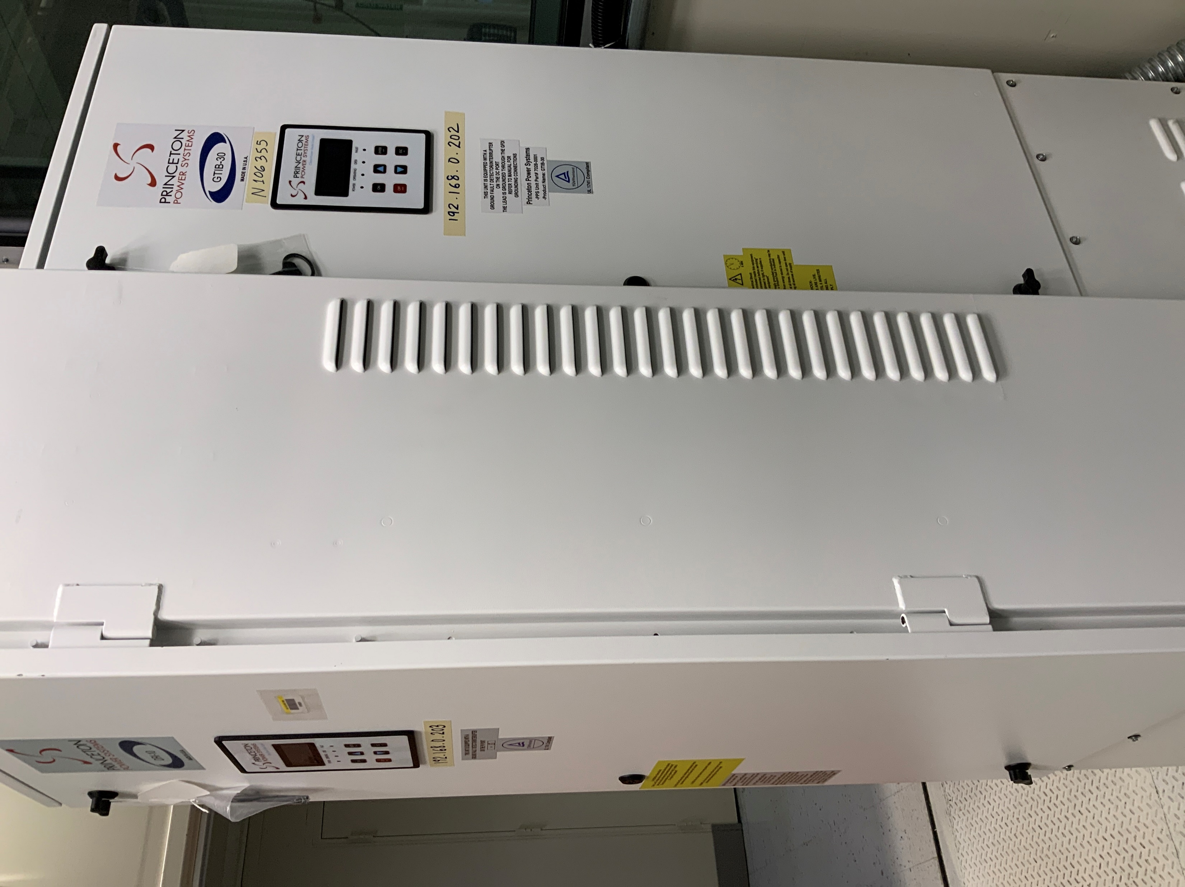
Motivation
Provide a “PV” input to inverters in the NIST Smart Grid Power Conditioning System
Inverter DC ports act as a voltage load with maximum power point (MPPT) tracking
“Alpha use case for Integrated Control and Data Acquisition System (ICDAS)
ICDAS usability trials
Discover issues not found during pre-commissioning tests of individual components.
Chroma 63800 Programmable Load
NHR 9200 Battery Test System
Integrated Control and Data Acquisition System
Princeton Power DRI and GTIB Inverters

Slide 3
Software Components
Integrated Control and Data Acquisition System
ACPwr Module
NHRDC Plugin
SolarArraySim.ini instance
ChromaAcLoad Plugin
SoarArraySim.ini instance
Python
.\ICDAS\UserFiles\Scripts\Solar Array Simulator\main.py
The “outer loop”
NIST_SG_SolarSim
Installed using “pip install git+https://github.com/usnistgov/NIST_SG_SolarSim”
Depends on: pvlib-python, pysimplegui, numpy, datetime, pytz, timezonefinder, etc.

Slide 4
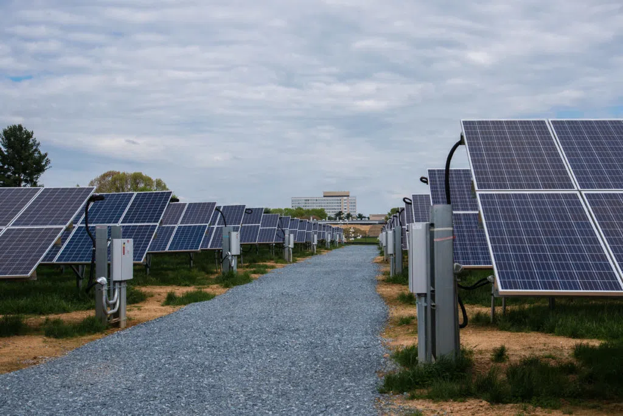
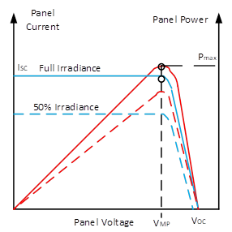
Theory
Maximum power point tracker
(MPPT)
+
-
“Constant”
Voltage
Load
(Photo: The 5.01 MW solar project at NIST’s campus in
Gaithersburg, Maryland.)
Solar panels act as a current source into a voltage load where the amount of current available depends on the amount of solar irradiance (blue line), the load voltage (and other factors).
The MPPT attempts to set the load voltage so that the power remains at the peak of the power curve (red line) depending on panel parameters, irradiance, temperature and other factors.
source: https://www.monolithicpower.com/en/battery-charger-with-mppt

Slide 5
Maximum Power Point Tracker
Well known algorithms for MPPT are:
Perturbation and observation: A simple algorithm which senses panel voltage and current then increases or decreases load voltage in fixed increments based on power and voltage (but not their derivatives).
Confused by rapid changes and it oscillates at the fixed increment amplitude
Incremental Conductance¹: Similar to P&O but it uses the derivatives of voltage, current and power
It is still confused by rapid changes in irradiance but not as badly as P&O
Fractional open-circuit voltage: based on the principle that the maximum power point is always some fraction of the open circuit voltage of the panel.
More are being researched and published: sometimes these are proprietary as squeezing every last watt from a solar panel is a competitive advantage.
¹ We are using Incremental Conductance Algorithm because it improved over P&O yet still simple to implement

Slide 6
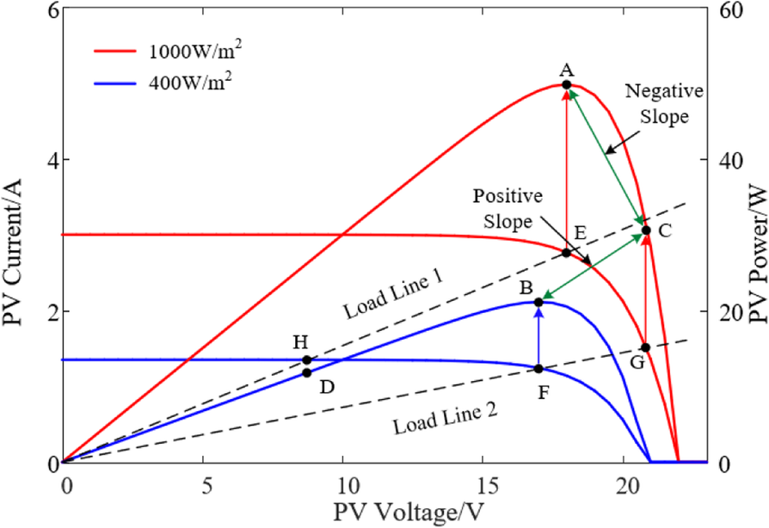
A well-known issue with Incremental Conductance (I.C.) MPPTs
At initial irradiance, the MPPT adjusts the load voltage along load line 2 and the MPP at point B is tracked.
Irradiance increases but the load voltage is maintained along load line 2, finding point G on the red I-V curve corresponding to point C on the red P-V curve.
The incremental inductance algorithm sees the gradient between points B and C as positive even though the actual gradient between point C and point A (the new MPP) is negative.
The I.C. algorithm changes the voltage in the wrong direction in the increasing irradiance scenario.
For decreasing irradiance there is no problem: the gradient along load line 2 between E and H is positive as is gradient from points A to D.
The NIST simulation / emulation illustrates this because we can fast-forward time and watch what happens as the I-V curve rises and falls rapidly over the course of a fast-forwarded day.
Source: Shang, L., Guo, H. & Zhu, W. An improved MPPT control strategy based on incremental conductance algorithm. Prot Control Mod Power Syst 5, 14 (2020). https://doi.org/10.1186/s41601-020-00161-z

Slide 7
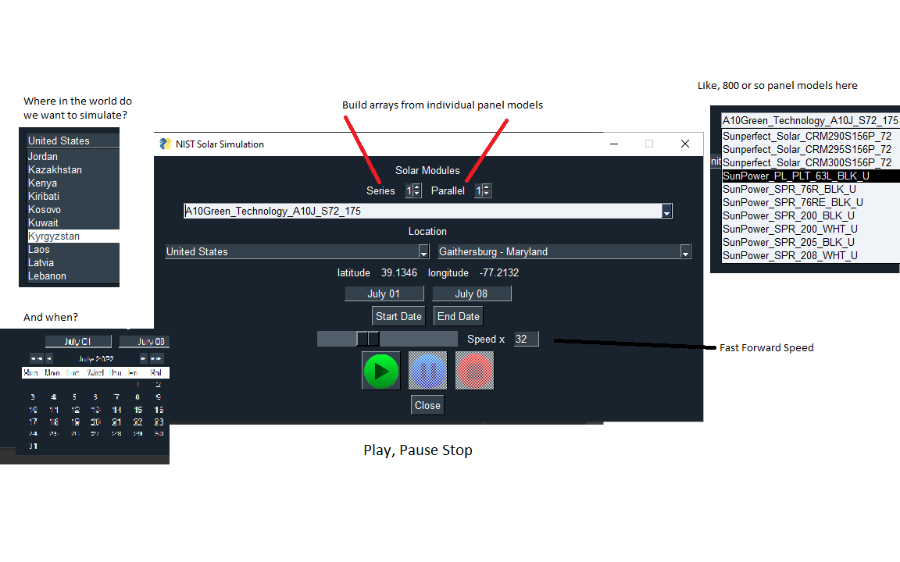
The Solar Simulation User Interface

Slide 8
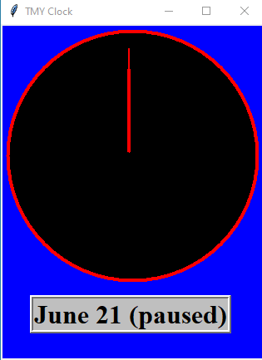
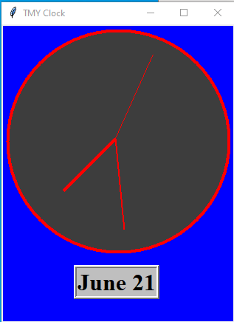
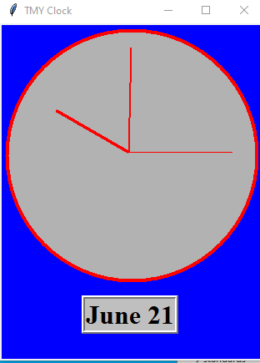
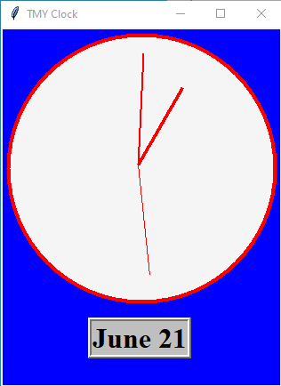
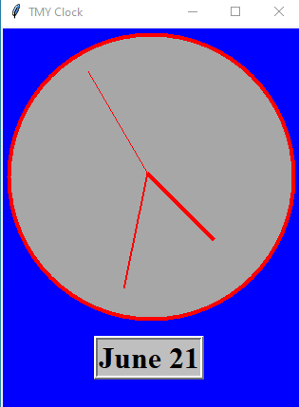
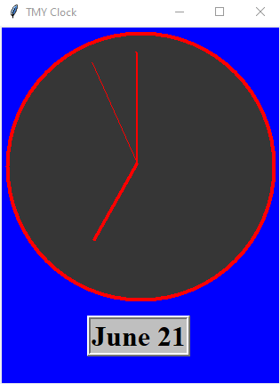
The Typical Meteorological Year (TMY) Clock
Downloads data from the PVGIS Photovoltaic Geographical Information System
https://joint-research-centre.ec.europa.eu/pvgis-photovoltaic-geographical-information-system/pvgis-tools/tmy-generator_en
1 hour, 4 m² resolution.
Provides irradiance (4 types), temperature, humidity, wind speed and direction, and surface pressure.
The TMY_Clock can provide interpolated data for the date range requested.

Slide 9
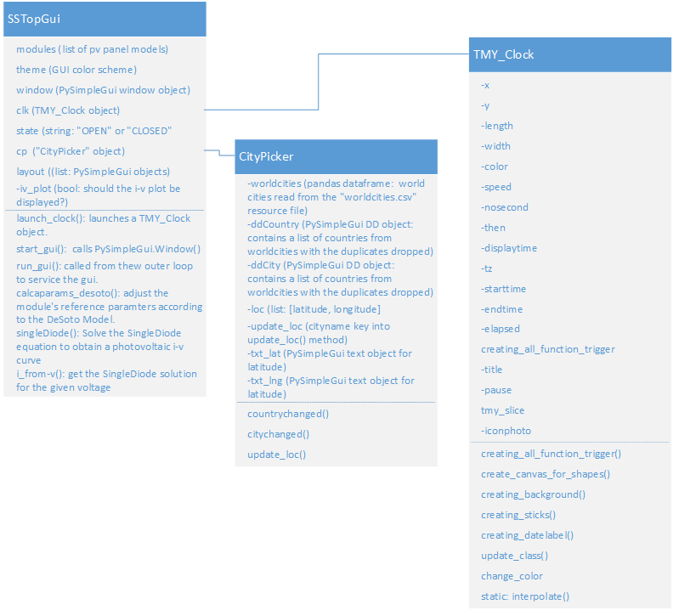
Under the Hood: The SAS GUI
“pip install git+https://github.com/usnistgov/NIST_SG_SolarSim”
ss_gui.py: top level graphical interface
class SSTopGui
class CityPicker
tmy_clock.py
class TMY_Clock
class
timezones.py
class timezones
TMY data is utc based so we need to know the local timezones to localize the data.

Slide 10
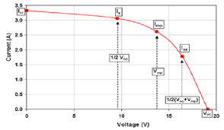
Solar Array Current – Voltage Curve
Once the TMY clock provides the irradiance, temperature and wind data, the chosen module data is input to the DeSoto¹ model to obtain the module parameters.
ToDo: the temperature used is the air temperature, we still need to use module, and wind data to determine the module temp.
The Single Diode Equation² is solved for the DeSoto model parameters. pvlib-python provides 5 points principal points of the i-v curve.
(0, Isc) = short circuit current
(½ Voc, Ix) = current at 0.5 Voc
(Vmp, Imp)= Voltage, current at max power point
(1/2 (Voc+Vmp), Ixx) = Voltage, current at (Vmp+Voc)
(Voc, 0) = open circuit voltage.
De Soto, W., S. A. Klein, et al. (2006). “Improvement and validation of a model for photovoltaic array performance.” Solar Energy 80(1): 78-88.
J.A. Duffie, W.A. Beckman (1991) “Solar Engineering Thermal Process” John Wiley and Sons, N.Y. 2nd ed.

Slide 11
NHRDC and Chroma Load Initialization
Preconfigure NHRDC in Charge Mode (acts as a current source)
Preconfigure Chroma Load in Constant Voltage Mode
Use ICDAS test file: .\ICDAS\UserFiles\Tests\SolarArraySim\SolarArraySim (Init and Run).tst
Init and Run scripts, first configures NHRDC and sets current output to 3 amps and voltage limit to 20 V dc. (The voltage limit will be increased later by the Python script)
Init and Run next configures the Chroma Load as Constant Voltage Load with voltage set to 20 V dc

Slide 12
Hardware issue during initialization
Alpha tests are good because only then do you find hidden issues:
Initializing the systems are not as clean as we would hope and voltage and current glitches cause occasional internal alarm shutdown of the load
Using the Reset script on the Chroma load will clear the alarm.
Two issues can occur:
An overtemperature shutdown with no visible cause in the measurement
If the Load and NHRDS voltage limit are not the same (20V) then an overvoltage alarm and shutdown on the Chroma can occur. There does seem to be a voltage spike in the measurement that is not limited by either the NHRDC voltage limit now the slew rate control
These issues, while not showstopping, bear some further investigation

Slide 13
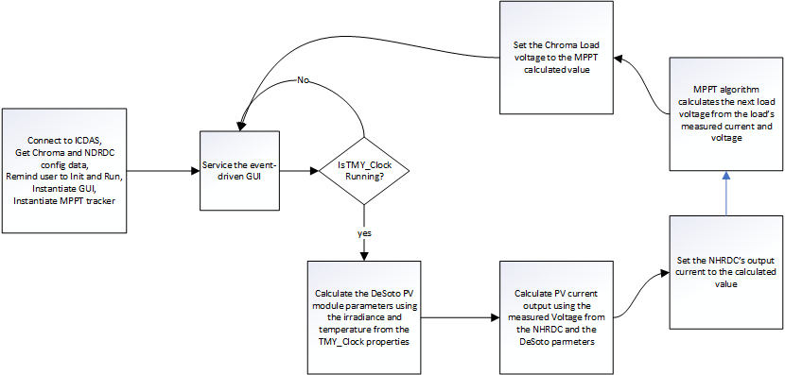
Solar Array Emulation Outer Loop
Once the hardware has been initialized, the “main.py” script runs an outer loop which drives the Solar Array Emulation:

Slide 14
Issues with the Chroma load as MPPT Emulator
Voltage load provided is about 10 V below voltage setting
Even with a minimum load setting of 20 V dc, the actual load voltage sometimes dips below 7.5 V dc
If the actual load voltage falls below 7.5 V then the load switches off
This happens occasionally at very low currents. (see plot next slide)
ICDAS Voltage and current meter reading output of the chroma and the NHR DC are instantaneous points, not averages and these tend to be noisy
This issue, in particular, creates some issues with the MPPT algorithm which uses derivatives of voltage and current.
The measurement loop on the chroma is slow and the visualization application is inefficient

Slide 15
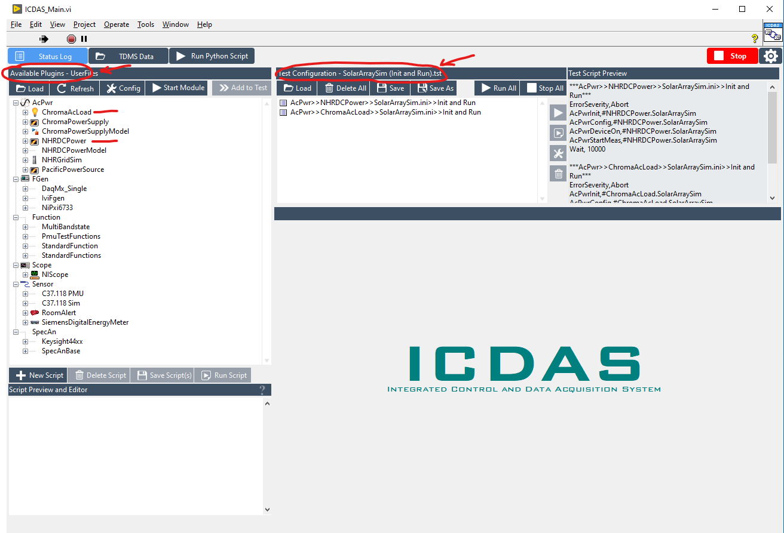
Tutorial 1a: Init and Run
After starting ICDAS be sure that:
“Available Plugins” is set to “Userfiles”
“Test Configurations” is set to “SolarArraySim (Init and Run),tst”
ICDAS recalls its last state when it was last stopped
Use the “Load” Button if needed

Slide 16
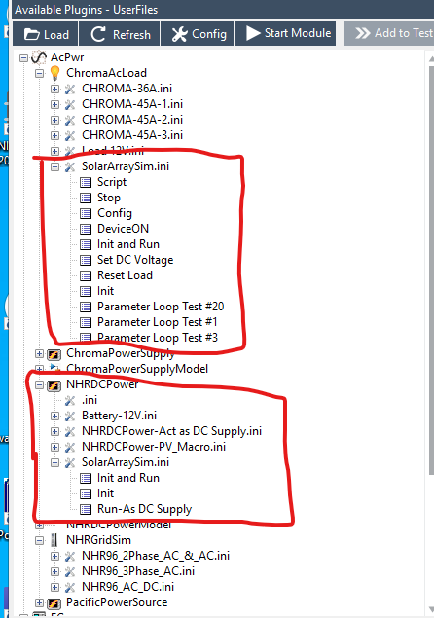
Tutorial 1b: SolarArraySim.ini files
For your information, the .ini files have been configured as shown in the next few slides
ChromaAcLoad/SolarArraySim.ini includes the “Init and Run” script and the “Reset Load” script
The other scripts were for development and test and can be ignored
NHRDCPower/ ChromaAcLoad/SolarArraySim.ini includes the “Init and Run” script.
Likewise, the others can be ignored

Slide 17
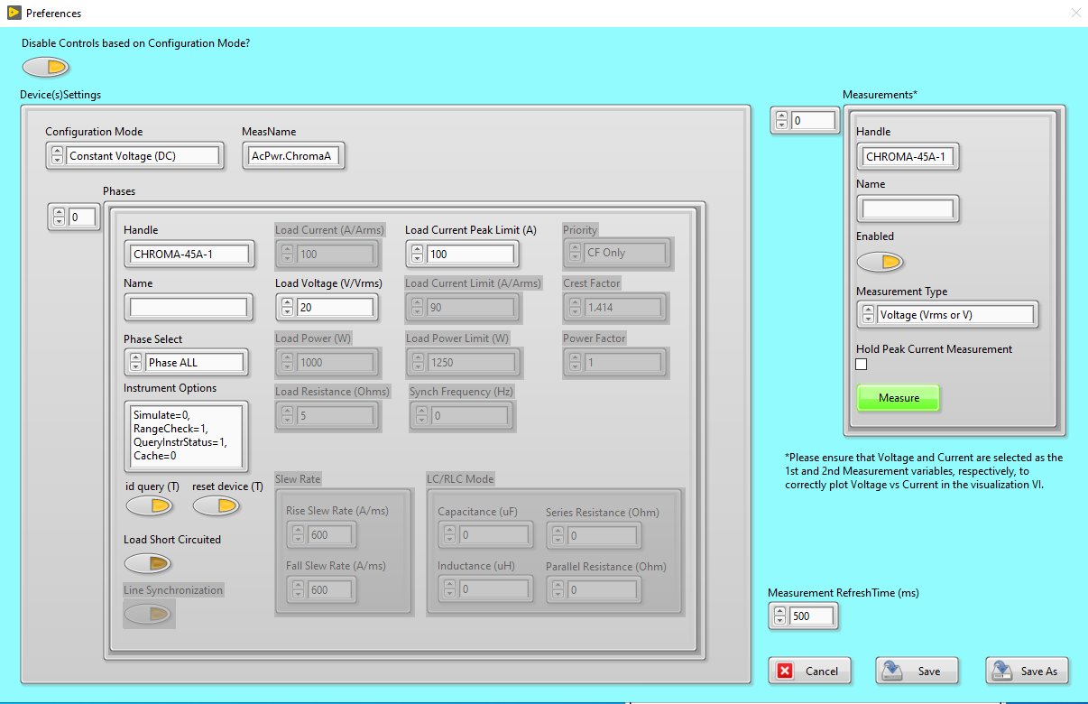
Tutorial 1c: ChromaAcLoad/SolarArraySim.ini Hardware Configuration
“Configuration Mode” is “Constant Voltage”
When changing Config. Mode, inactive controls will be disabled
“Load Voltage” is set to 20 V
“Load Current Peak Limit” set to 100 A
Note the “Measurement Refresh Time” is 500 ms
This is due to issues in the Visualization which should be addressed
After that the refresh time should be dropped to 50 ms or so.

Slide 18
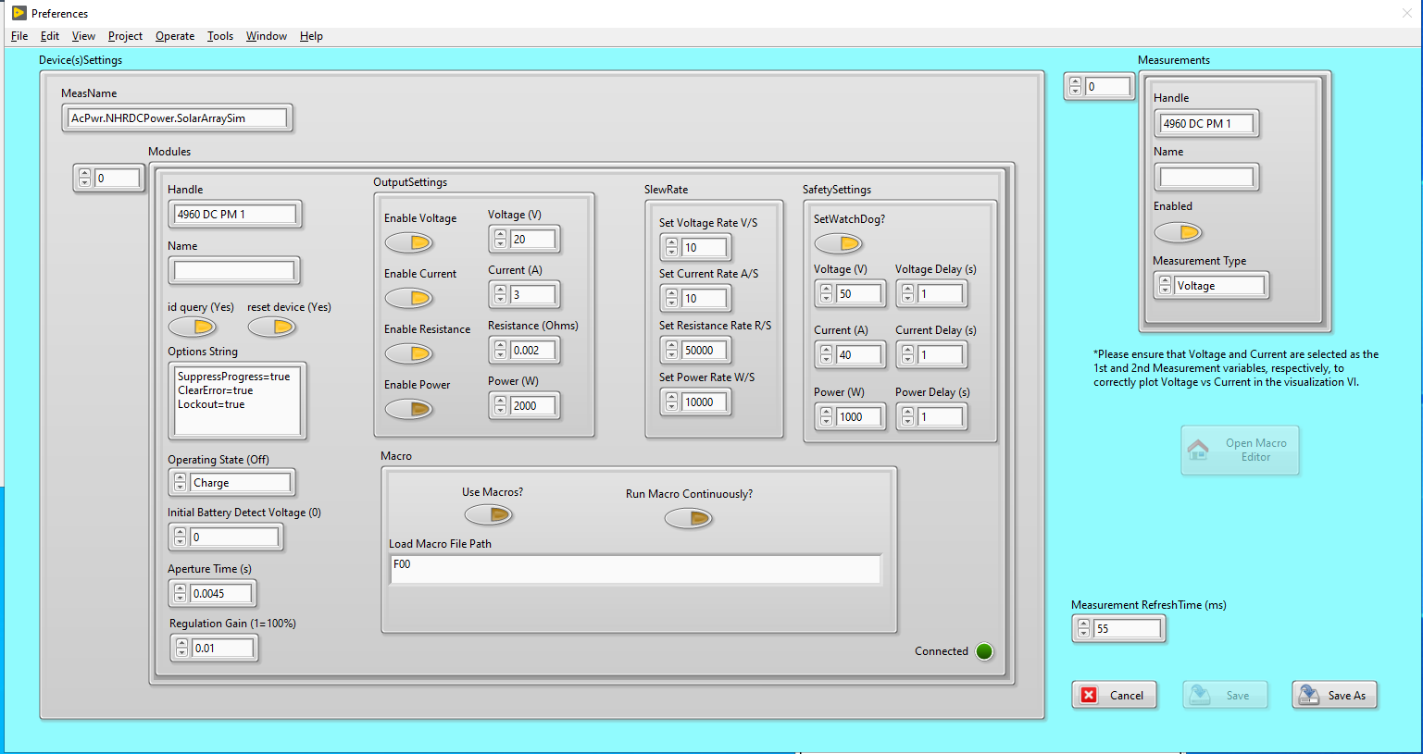
Tutorial 1d: ChromaAcLoad/SolarArraySim.ini Hardware Configuration
“Operating State” is “Charge”
“Voltage” is set to 20 V
Same as load
Will be changed in outer loop startup
“Current” set to 3 A
“SlewRates” for voltage and current are 10 /s but only are effective when the setpoint is changes, not during glitches.
“Measurement Refresh Time” is 50 ms

Slide 19
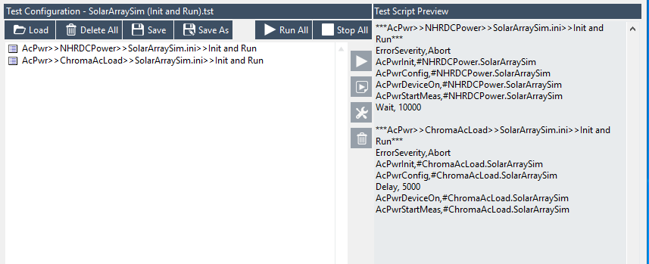
Tutorial 1e: Init and Run Scripts
NHRDCPower>>SolarArraySim.ini>Init and Run runs first
ChromaAcLoad>>SolarArraySim.ini>Init and Run runs second
ErrorSeverity sets up the error handing user interface. Abort allows for a test to be aborted or continued by the user
10 second wait follows NHRDC to ensure it has settled before starting the load

Slide 20
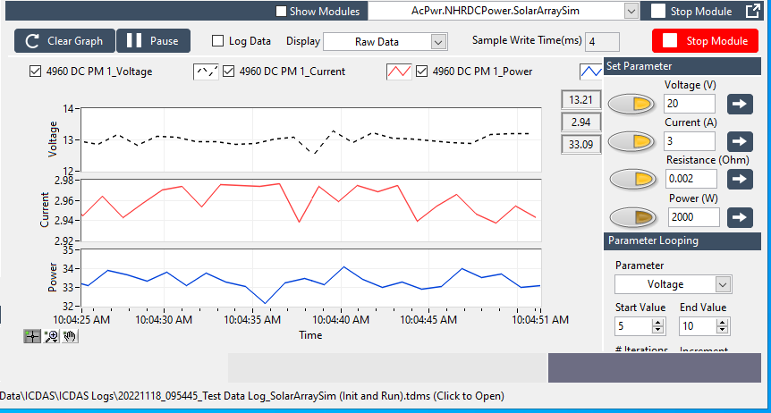
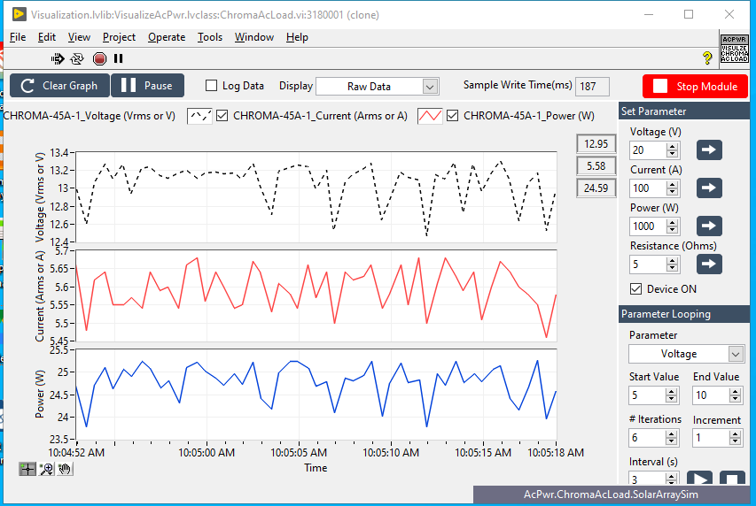
Tutorial 1f: Run All
Init and Run scripts run when the “Run All button is clicked
2 NistPluggableModules start (normally hidden)
AcPwr Plugins Load into each module
SolarArraySim.ini configurations load into the plugins
Visualization apps for both plugins load
Scripts (shown on the previous slide) run
Measurements are started and display in the Visualization apps

Slide 21
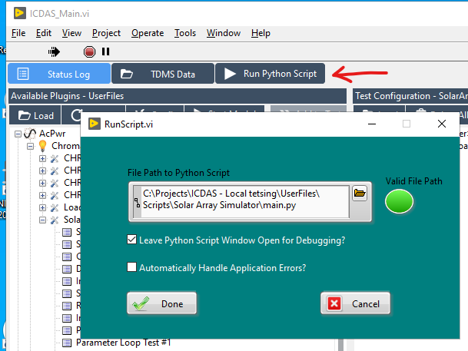
Tutorial 2a: Run Python Script
Press the Run Python Script button to open the dialog
Unfortunately, ICDAS does not remember the last script so you will need to brose into the “UserFiles/Scripts” and open “main.py” folder. (ToDo item)
“Leave Python Script Window Open…” will allow you to see Python errors and messages adfter the script completes.
“Automatically Handle Application Errors” if for unattended operation where errirs that can be handled by the system are handled without stopping the outer loop.
SolarArraySim does not handle errors automatically (ToDo item)
Click “Done” to start the “main.py” Python Script

Slide 22
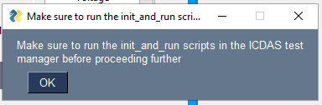
Tutorial 2b: Reminder to run Init and Run
A windows command window will open.
The pop-up shown above appears
Chances are the ICDAS “Init and Run” scripts have already been run, but Python reminds the user just in case…
Click “OK”

Slide 23
Tutorial 2C: The Solar Simulation User Interface (repeat of slide 7)

Slide 24
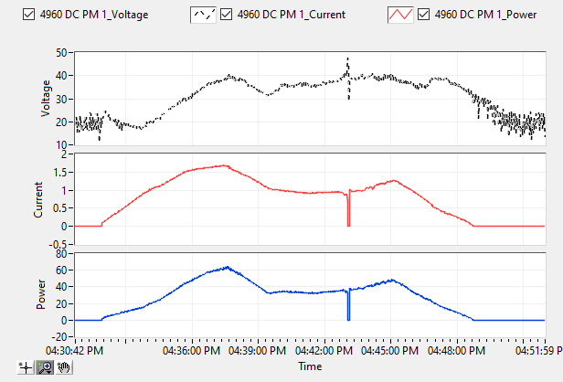
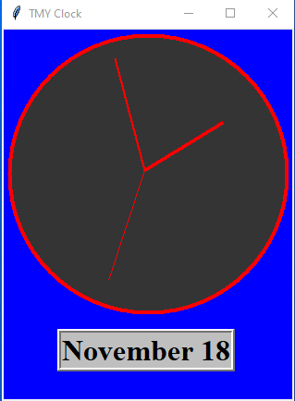
Tutorial 2d: Press Play
Play on the GUI starts the simulation
Speed control slider changes the simulation speed
An issue with the Chroma load causes spurious 600V overvoltage protection glitches that need to be looked into.
We do not think that the NHRDC is actually outputting these high voltages
November 18th, Typical Meteorological Year 6 am to 8 pm at 32 x speed. The glitch in the middle of the day is due to a spurious overvoltage protection by the Chroma Load. This caused the load to open circuit temporarily. We do not believe the voltage actually got to 600V. But was more likely below 40V dc

Slide 25
Questions?

